Slide 1














StokTrak Portfolio:
Buy and Hold Strategy
By: Sarai Hrinsin

Slide 2

Buy and Hold: What does it mean?
The Buy and Hold Strategy is a process where an investors purchase stocks (such as EFTs), bonds and/or mutual funds, and hold them for a long period of time, disregarding the fluctuations of the market.
According to Investopedia.com, The Buy and Hold strategy when it comes to investing in stocks, bonds, and mutual funds is described as a “long-term passive strategy where investors keep a relatively stable portfolio over time, regardless of short-term fluctuations”.
This can, supposedly, ultimately lead to outperforming day to day trading portfolios and eventually defer capital gains taxes.

Slide 3
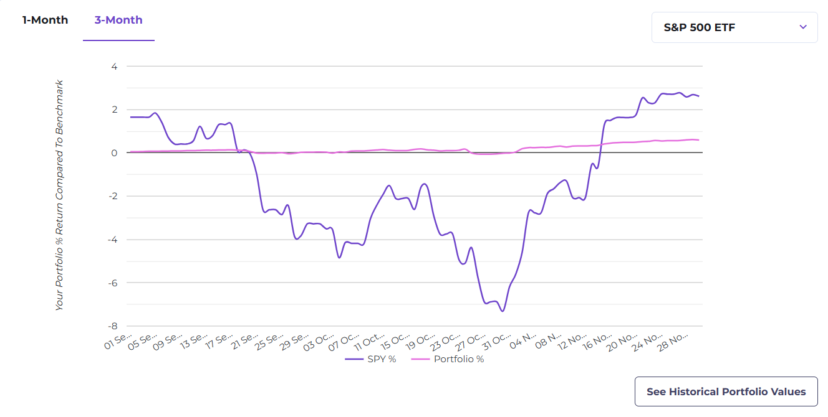


My Portfolio:
As we can see from the Portfolio chart, my specific portfolio, when compared to S&P, stayed relatively constant. This proves the Buy and Hold strategy, in this case.
You can see, around the end of October, when the market took a significant dip, my portfolio also decreased slightly. However, it was a minor dip, for a relatively short period of time.
Once the market started to rebound, my portfolio also reaped the benefits of increasing. While the slope is gentle, it is increasing.

Slide 4







What trades did I partake in?
I mainly used P/E Ratios and Industry categories to determine which trades to do. While Shopify has an alarming P/E Ratio, I knew it was an up-and-coming e-commerce platform, and it actually ended up being fairly profitable.
Kellogg Co. (K)
Alphabet Inc. (GOOG)
Shopify Inc. (SHOP)
T. Rowe Price Capital Appreciation (PRWCX)
Industry: Consumer Non-Durables
P/E Ratio: 20.91
Dividend Yield: 3.28467
Industry: Technology Services
P/E Ratio: 25.68
Dividend Yield: 0
Industry: Retail Trade
P/E Ratio: -59.41
Dividend Yield: 0
Fund Category: Moderate Allocation
P/E Ratio: 23.62
Yield: 1.36

Slide 5

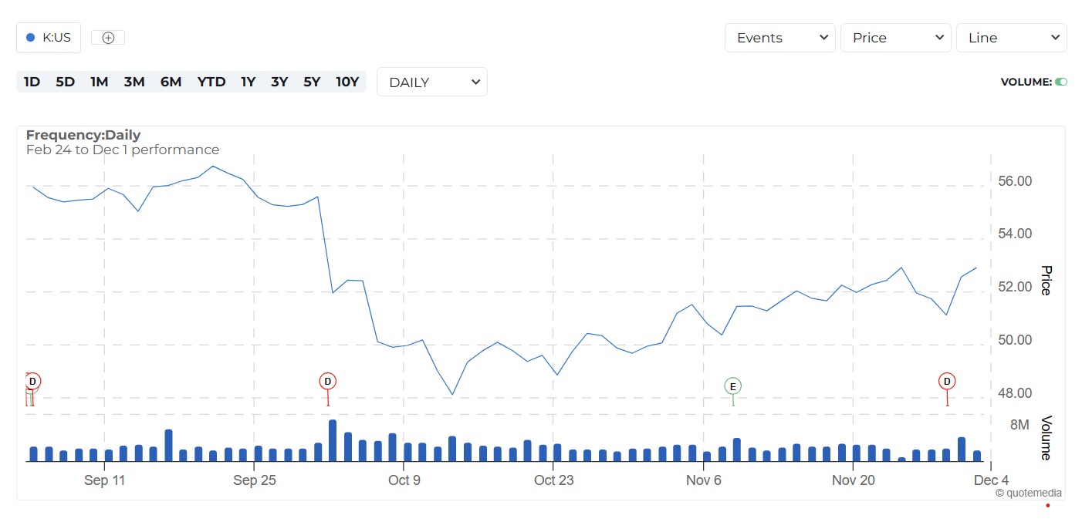
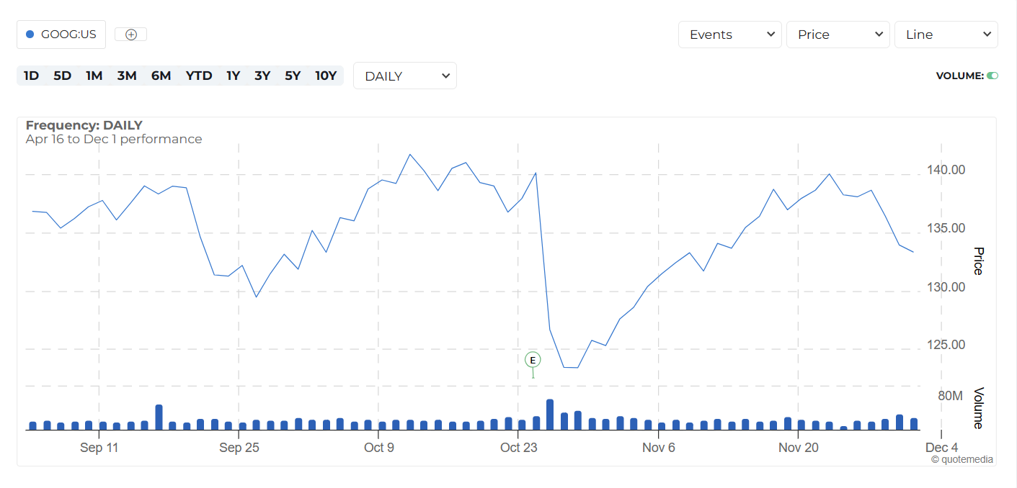
Kellog Co. (K)
Market dip around end of October.
Cash dividends
Aug 30: $0.60
Oct 1: $3.34
Nov 29: $0.56
Alphabet Inc. (GOOG)
Market dip around end of October.
Earning Event:
Oct 24: 14 analysts projected an EPS of $1.45. Actual EPS of $1.55.

Slide 6
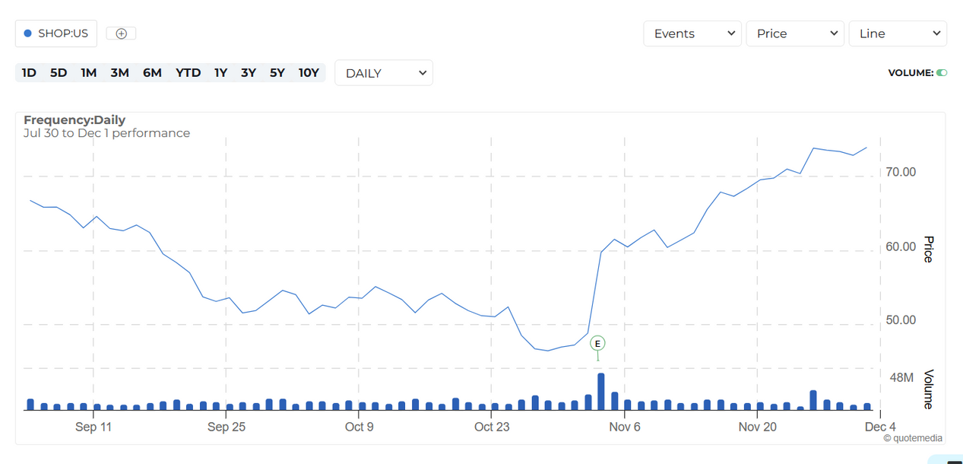
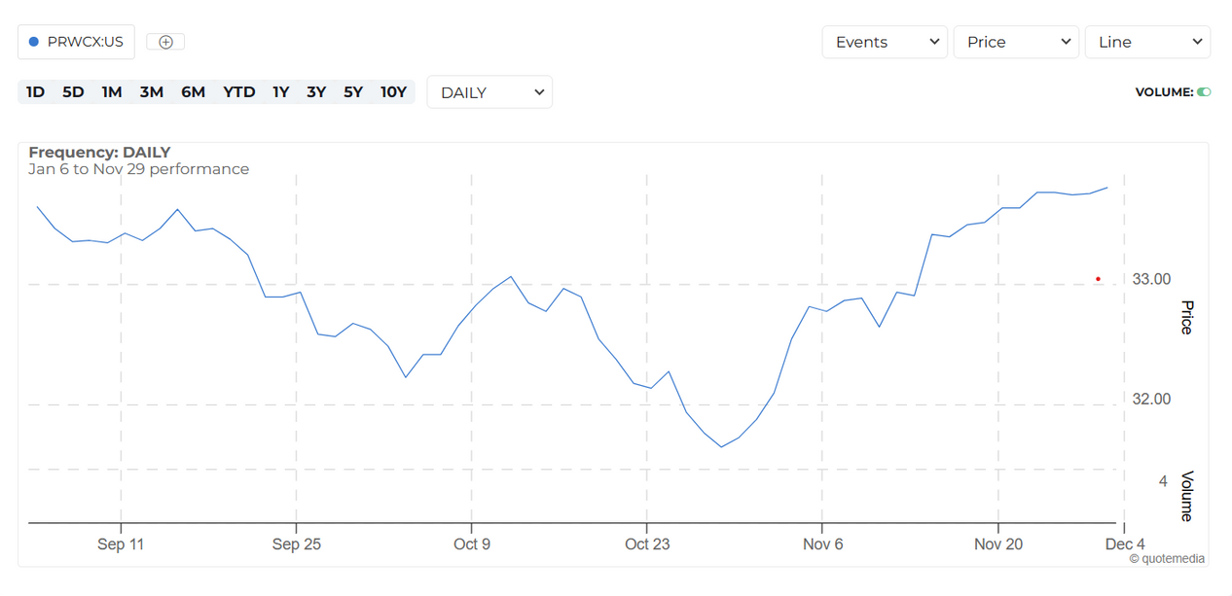
Shopify Inc. (SHOP)
Market dip at the end of October. (more gradual but did stay in in it longer than others)
Earnings Event
Nov 2: 13 analysts projected an EPS of $0.06. Actual EPS of $0.17.
T. Rowe Price Capital Appreciation (PRWCX)
Market dip at the end of October. (more gradual but did not stay long)
Last Dividend was December 18, 2022 of $0.47.

Slide 7

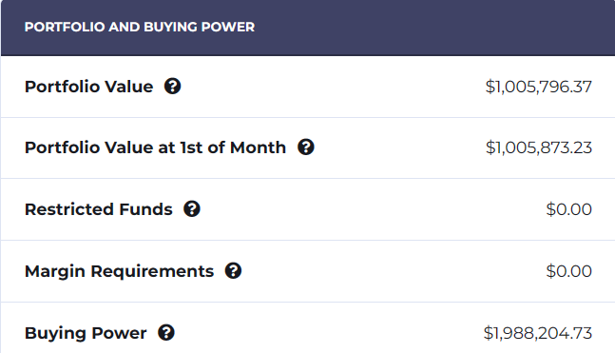
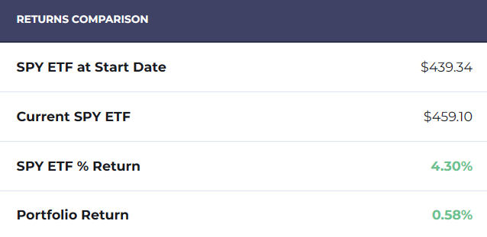
Buy and Hold: Did it work?
While the portfolio return is only 0.58%, my portfolio did, relatively, remain constant even through market fluctuations.
While a small amount compared to one million, I did gain almost $6,000.00 in value.

Slide 8
Conclusion:
The Buy and Hold strategy does allow you to have a more stable portfolio that doesn’t adhere as harshly to market fluctuations.
However, it does progress relatively slowly, and you could miss out on selling at optimal times in the market.
This strategy is good for you if you are cautious of risk and have the time and patience to see it through. You also need to know to understand when you need to eventually sell.

Slide 9



Thank you very much!

